Slide 1
VARIANTS OF AORTIC ARCH : OUR EXPERIENCE
M. BOUSSALAH, N. TOUIL, S. HABCHAOUI, O. KACIMI, N. CHIKHAOUI
Emergency Radiology Department, Ibn Roch University Hospital, Casablanca, Morroco
VARIOUS VR : 9

Slide 2
INTRODUCTION :
Aortic abnormalities are common cardiovascular malformations, accounting for 15% to 20% of all congenital cardiovascular diseases [1].
The aortic arch is one of this abnormalities, with well known variations.
The anomalies of branches arising from the aortic arch result from errors in the embryologic development of the branchial arches, including errors of involution or migration, or abnormal persistence of vascular structures.

Slide 3
INTRODUCTION :
Advances in imaging technology have made their identification easily possible.
Most arch abnormalities consist of errors of laterality or aberrations in the level of interruption of the primitive branchial arches, which determine the presence or absence of aberrant supra-aortic branches. [1]
They can be discovered when there are symptoms of airway or esophageal compression produced by vascular rings [2], or anomalies can be found incidentally on imaging studies obtained for unrelated indications.

Slide 4
INTRODUCTION :
An understanding of the normal embryologic development of the arch, coupled with knowledge of the imaging features of malformations, may aid both adult and pediatric radiologists in making correct interpretations of these anomalies.
Failure to recognize a critical aortic arch branch variation at surgery may cause serious consequences [3]. Therefore, preoperative imaging studies such as magnetic resonance imaging or Computed Tomography (CT) should be carefully reviewed to prevent the complication.

Slide 5
MATERIELS AND METHODS :
We describe CT and angiographic finding in patients with complex anomaly of the origin or position of supraaortic vessels, incidentally discovered :
    Common trunk betwwen the innominate artery and the left common carotid artery : 4 patients;
    A Bicarotid trunk (troncus bicaroticus) : 1 patient;
    An arteria lusoria arising from a common trunk between the subclavian arteries : 1 patient;
    A left vertebral artery with an anomalous origin from the aortic arch : 2 patients,
    A right vertebral artery originating from the right brachiocephalic artery : 1 patient.

Slide 6
NORMAL ANATOMY :
In specimens of normal variety, the branches leave the aortic arch in the following succession from left to right: left subclavian artery (LSA), left common carotid (LCCA) and brachiocephalic trunk (with right common carotid (RCCA) and right subclavian (RSA) as its derivatives) [Figure. 1].
The verberal arteries originate from the subclavian arteries.
According to Anson et al., the normal three-branched arrangement of the aortic arch is found in 64.9% [4].

Slide 7
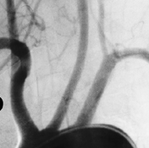
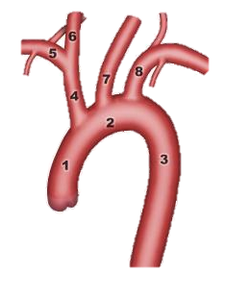
NORMAL ANATOMY :
10
9
Figu. 1 : Angiographic finding and schematic representation of normal origin of supra aortic vessels.
1. Ascending aort, 2. Arch of aorta, 3. Descendaing aorta, 4. Inominate artery, 5. Right subclavian artery, 6. Right common carotid artery, 7. Left common carotid artery, 8. Left subclavian artery, 9. Right vertebral artery, 10. Left vertebral artery.

Slide 8
EMBRYOLOGIC CONSIDERATIONS : The Rathke Diagram
The development of the branchial apparatus begins during the second week of gestation and is completed by the seventh week.
It consists of 6 branchial arches in the wall of the foregut, numbered 1 to 6 from cephalad to caudad. Each connects paired dorsal and ventral aortas [5].
The 6 branchial aortic arches normally develop into the thoracic aorta and its branches (Figure. 2) : [5]
  The first 2 arches involute before development of the sixth arch, and the fifth arch is atretic or never fully develops.
  The third arch contribute to the head and neck arteries.
  The fourth arch becomes the aortic arch, and the pulmonary arteries develop from the sixth branchial arches.
  On the right side, the dorsal contribution of the sixth arch disappears, and on the left it persists as the ductus arteriosus. The intersegmental arteries migrate and form the subclavian arteries.

Slide 9
EMBRYOLOGIC CONSIDERATIONS : The Rathke Diagram
Figure 2 : A and B, Schematic representation of the development of the normal aortic arch and its branches from the Rathke diagram. A, Black-shaded branchial arch segments (numbers 1, 2, 5) represent portions of arches that disappear. Red branchial arches (numbers 3, 4, 6) remain and develop into arteries. Intersegmental artery (asterisk). B, Fourth arch develops into the aortic arch (number 4). The ventral bud of the sixth arch evolves into the pulmonary artery (number 6). Portions of the third arch (number 3) and ventral portions of branchial arches contribute to left common, external and internal carotid arteries (arrows). Long thin arrows indicate cranial migration of inter-segmental arteries (asterisk), which later form subclavian arteries. [5]
IA, indicates inter-segmental artery; LCCA, left common carotid artery; LECA, left external carotid artery; LICA, left internal carotid artery; RCCA, right common carotid artery; RECA, right external carotid artery; RICA, right internal carotid artery.

Slide 10
EMBRYOLOGIC CONSIDERATIONS : The Edward Hypothetical double Arch
FIGURE 3 [5]: Schematic representation of the Edward Hypothetical Double Arch. Bilateral common carotid arteries and subclavian arteries arise from each of the 2 aortic arches as independent arteries. The ventral portions of the sixth branchial arches form the pulmonary artery and the dorsal portions of the sixth branchial arch become ductus arteriosus. The seventh inter-segmental arteries assume a position between PDA and common carotid arteries.
LCCA indicates left common carotid artery; LDA, left ductus arteriosus; LECA, left external carotid artery; LICA, left internal carotid artery; LPA, left pulmonary artery; LSA, left subclavian artery; RCCA, right common carotid artery; RDA, right ductus arteriosus; RECA, right external carotid artery; RICA, right internal carotid artery; RPA, right pulmonary artery; RSA, right subclavian artery.

Slide 11
CLASSIFICATION OF AORTIC ARCH ANOMALIES :
Anatomical classification :
    based on the absence, course, or position of the aortic arch, also on the order or pattern of branching of the great vessels,
    May be characterized as right sided aortic arch, left sided aortic arch, double aortic arch or cervical aortic arch.
Clinical presentation or morphology :
    Asymptomatic cases,
    Cases with clinical symptoms : tracheobronchial and/or esophageal compression,
    Cases in which there’s isolation of aortic arch branches and alteration of normal blood flow.

Slide 12
CLASSIFICATION OF AORTIC ARCH ANOMALIES :
Table 1: Classification of Congenital Abnormalities of the Thoracic Aorta [6]
Classification considers the side of the aortic arch, the location of great vessels, and the side of the descending aorta.
LAA: left aortic arch; LBCA: left brachiocephalic artery; LCCA: left common carotid artery; LDA: left ductus arteriosus; LSCA: left subclavian artery; RAA: right aortic arch; RBCA: right brachiocephalic artery; RCCA: right common carotid artery, RSCA: right subclavian artery.

Slide 13
CLASSIFICATION OF AORTIC ARCH ANOMALIES :
Figure 4 : Aortic arch variations. 1. Normal presentation, 2. Common trunk between the LCCA and the inominate artery, 3. LCCA arising from the innominate artery, 4. LVA rising directly from the aorta, 5. ARSA.
LCCA: left common carotid artery; ARSA: Aberrant right subclavian artery, LVA: left vertebral artery.

Slide 14
INCIDENCE OF AORTIC ARCH ANOMALIES :
Table 2: Comparaison of incidence of each variation of aortic arch branches in litterature (%) [7].
ARSA: Aberrant right subclavian artery, BCA: brachiocephalic artery, LCCA: left common carotid artery; LSA : left subclavian artery, LVA: left vertebral artery, RCCA: right common carotid artery, RSA: right subclavian artery, RVA: right vertebral artery.

Slide 15
ABERRANT RIGHT SUBCLAVIAN ARTERY : ARTERIA LUSORIA (ARSA)
This anomaly occurs in approximately 1% to 2% of patients, when there is a break in the primitive right arch between the right common carotid and subclavian arteries (Fig. 5) [8].
The ARSA travels from the left aortic arch, behind the esophagus, to perfuse the right upper extremity.
Usually asymptomatic, but could cause dysphagia or dyspnea.
we describe a complex anomaly of supra aortic vessels : An arteria lusoria arising from a common trunk between the subclavian arteries, associated to a truncus bicaroticus (Fig. 6-7).

Slide 16
ABERRANT RIGHT SUBCLAVIAN ARTERY : ARTERIA LUSORIA (ARSA)
Figure 5: A and B, Schematic representation of the left aortic arch with ARSA. A, Black-shaded area represents the position of the break in a hypothetical arch. Arrows point to great vessels, ductus arteriosus, and left ductus arteriosus. Curved arrows point to right and left subclavian arteries. B, Schematic representation of the evolution of the left arch and ARSA (arrow). Arrows point to arch vessels. [5].

Slide 17
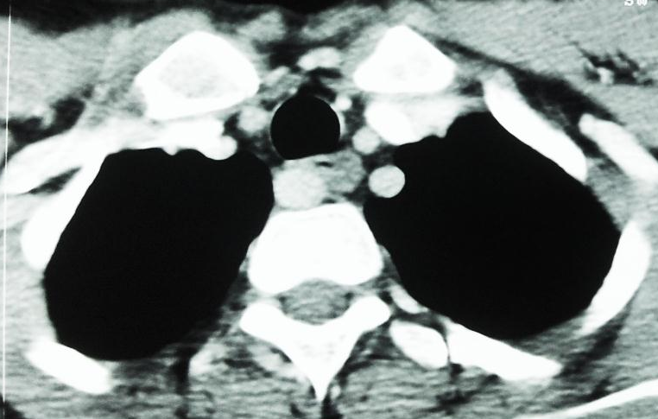
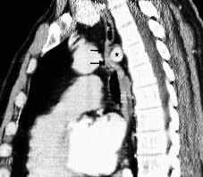
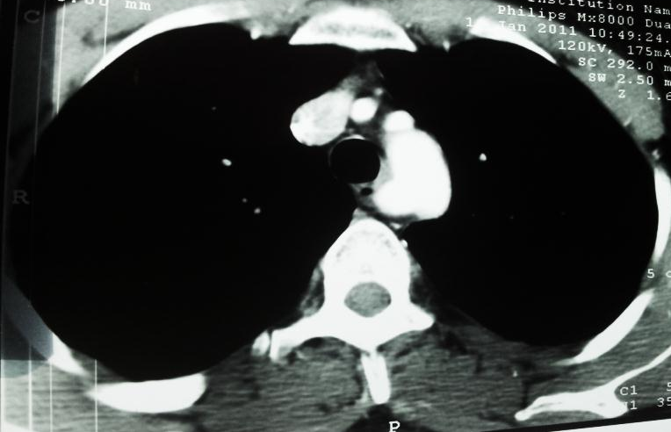
ABERRANT RIGHT SUBCLAVIAN ARTERY : ARTERIA LUSORIA (ARSA)
ARSA
ARSA
A
T
Arcus Ao
E
B
C
Figure. 6 : Conrast-enhance MDCT showing arteria lusoria : Axial (A and B) and sagittal (C) images show aberrant right subclavian artery (ARSA) compressing esophagus (E) through a posterior course (black arow).
Arcus Ao : Aortic arch. E: esophagus, T : trachea

Slide 18
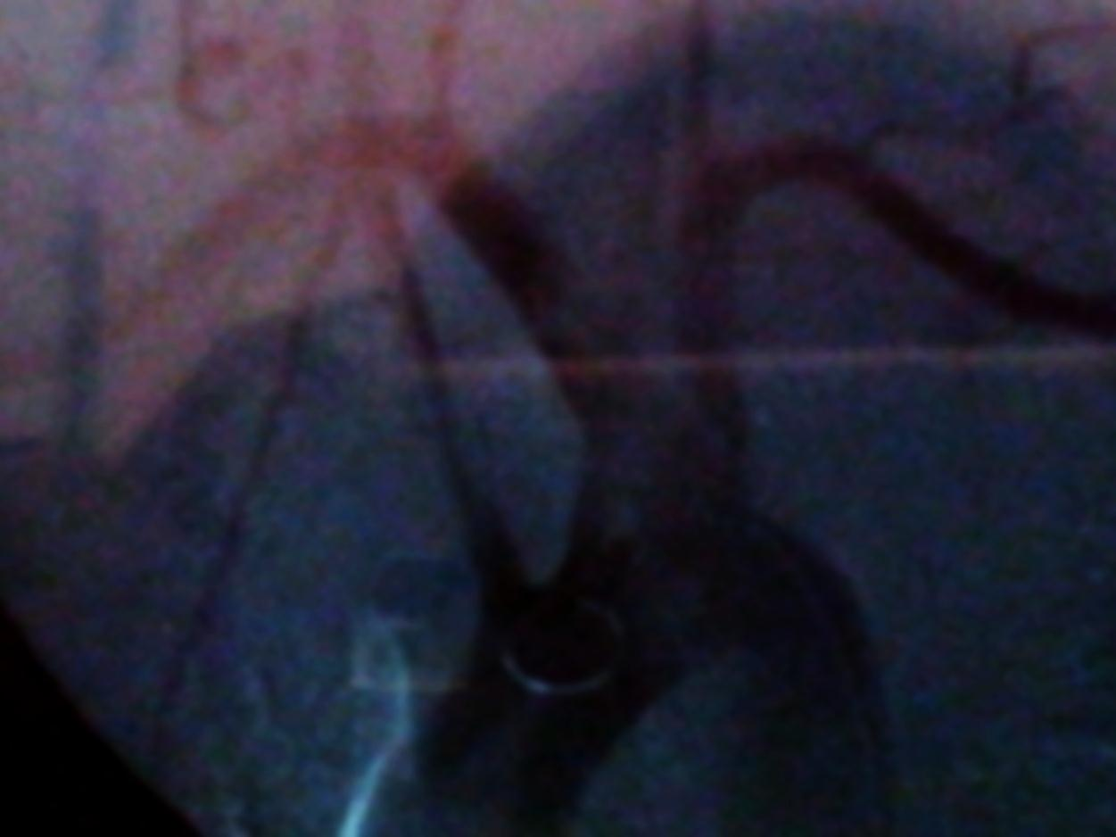
ABERRANT RIGHT SUBCLAVIAN ARTERY : ARTERIA LUSORIA (ARSA)
RCCA
ARSA
LSCA
LCCA
Trunk
Trunc bic
Arcus Ao
Figure. 7 : Antero-posterior projection digital substraction aortogram demonstrating an ARSA arising from a common trunk between the subclavian arteries, and associated to a truncus bicaroticus.
Arcus Ao : Aortic arch, ARSA : aberrant right subclavian artery, LCCA : left common carotid artery, LSCA : left subclavian artery, RCCA : right cammon carotid artery, Trunc bic : truncus bicaroticus.

Slide 19
COMMON TRUNK OF LCCA AND RBA :
Common carotid artery rising from the innominate occurs in 27.1% [9].
The LCCA can take origin from :
    Very close to the stem,
    Slightly above the stem of the BCA,
    Higher than the previous two cases.
    We present angiographic finding in 4 patients (Fig. 8-9).

Slide 20
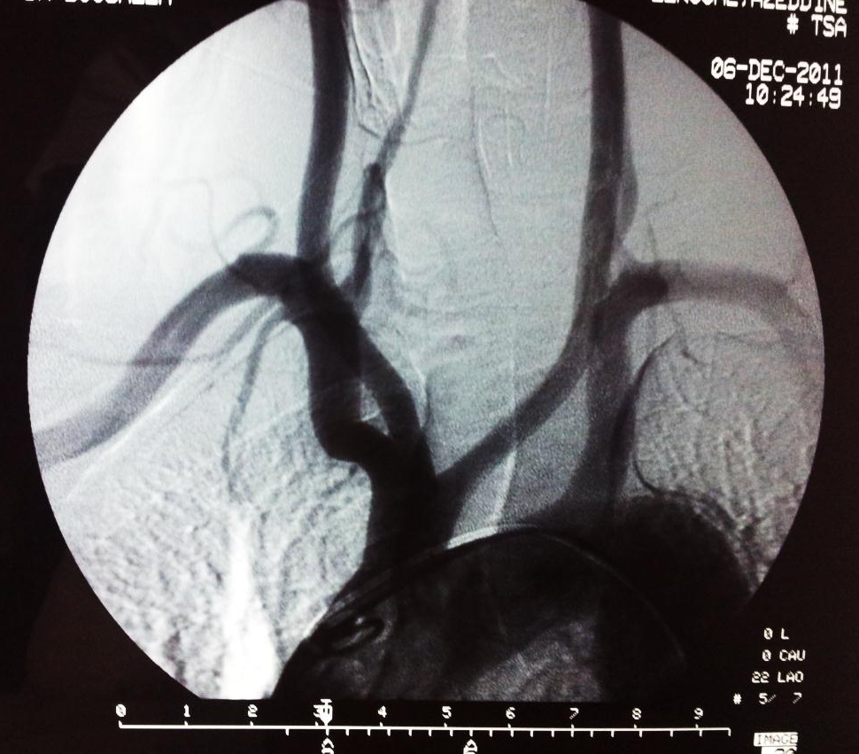
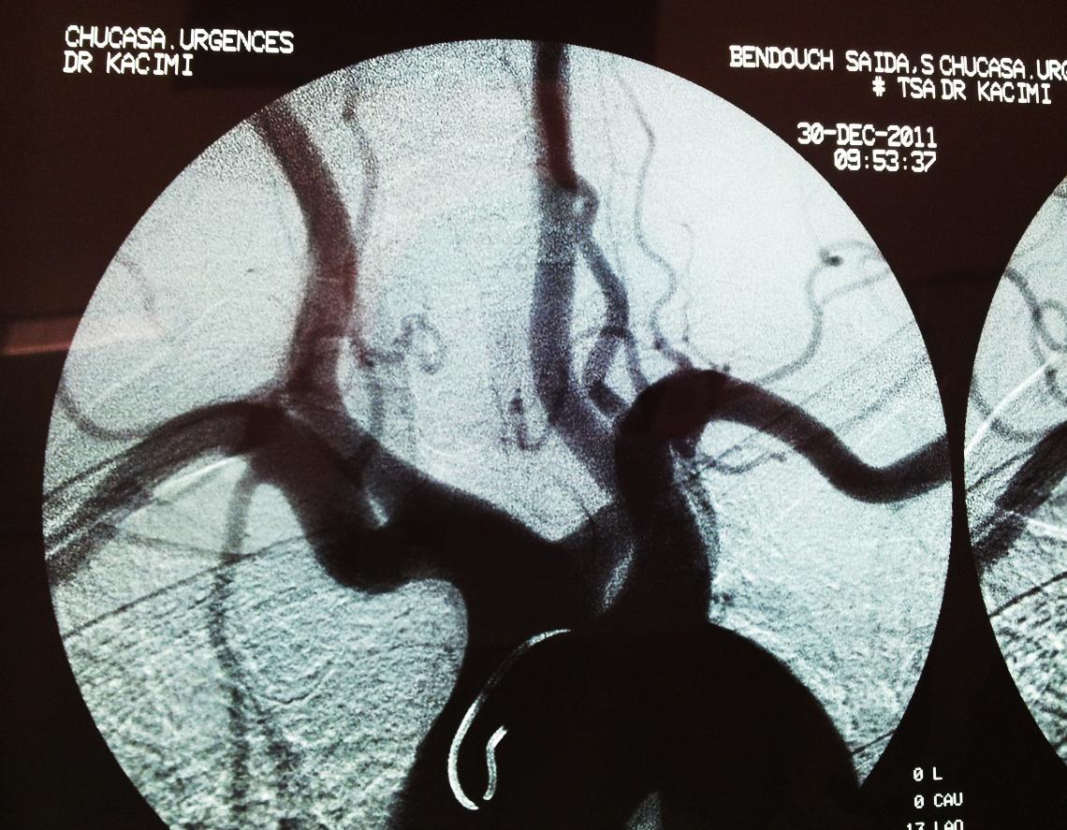
COMMON TRUNK OF LCCA AND RBA :
RCCA
LCCA
RCCA
LCCA
RSCA
LSCA
LSCA
RSCA
Arcus Ao
Arcus Ao
Figure. 8 : Antero-posterior projection digital substraction aortogram demonstrating common trunk between the left common carotid artery and the right brachiocephalic artery in two patients.
Arcus Ao : Aortic arch, LCCA : left common carotid artery, LSCA : left subclavian artery, RCCA : right cammon carotid artery, RSCA : right subclavian artery, Trunc bic : truncus bicaroticus.

Slide 21
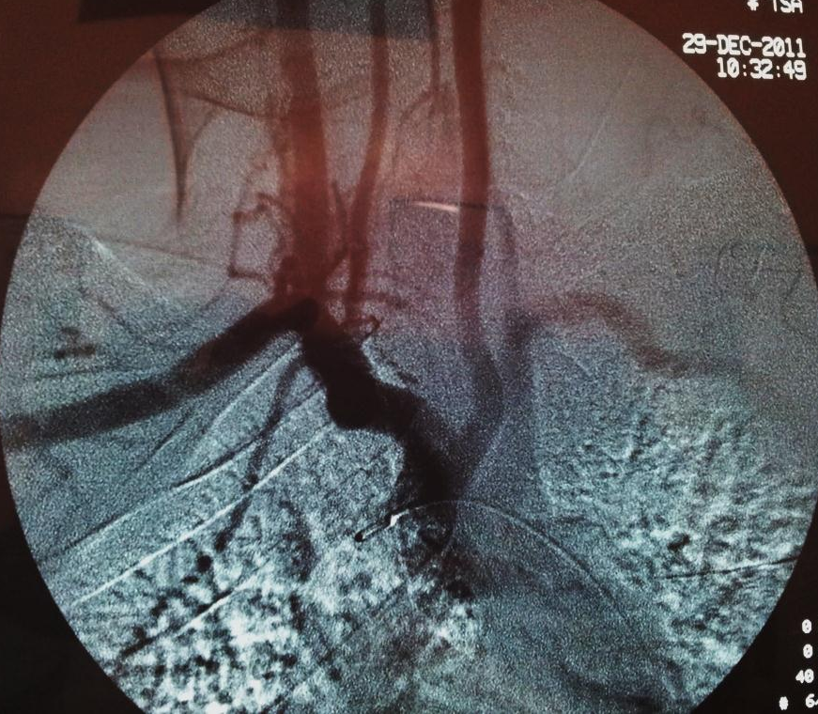
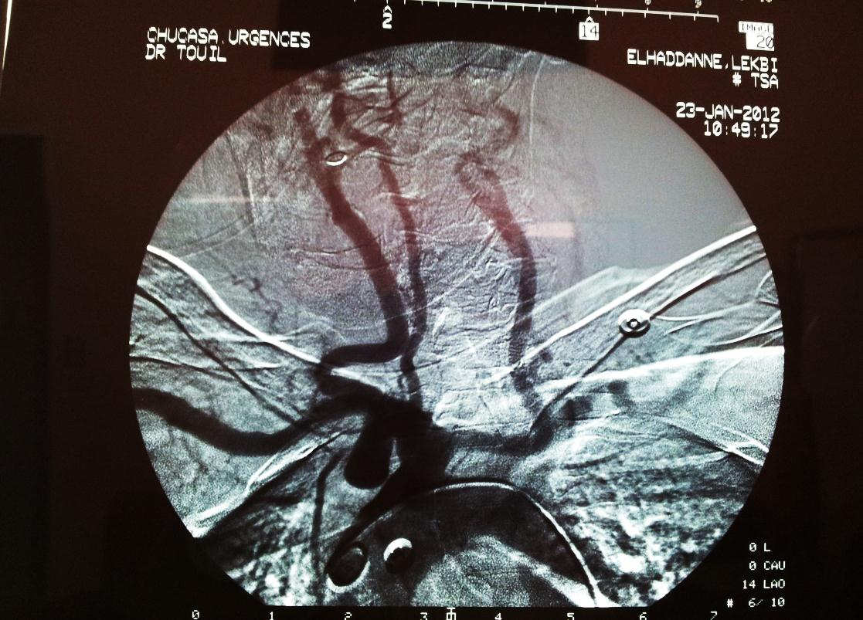
COMMON TRUNK OF LCCA AND RBA :
Figure. 9 : Antero-posterior projection digital substraction aortogram demonstrating common trunk between the left common carotid artery and the right brachiocephalic artery in two patients.

Slide 22

Truncus bicaroticus :
RCCA
ARSA
LSCA
LCCA
Trunc bic
Arcus Ao
Figure. 10 : Antero-posterior projection digital substraction aortogram demonstrating a truncus bicaroticus associated to an ARSA
Arcus Ao : Aortic arch, ARSA : aberrant right subclavian artery, LCCA : left common carotid artery, LSCA : left subclavian artery, RCCA : right cammon carotid artery, Trunc bic : truncus bicaroticus.

Slide 23
VERTEBRAL ARTERIES VARIANTS :
    The anomalous origin of vertebral arteries are rare.
    The most common is a left vertebral artery rising as a branch of the aortic arch, between the origins of LCC and LSA.
    It developed from the persistent sixth cervical inter-segmental artery [9].
    Anatomical and morphological variations of the vertebral artery are of great importance in surgery, angiography and all non-invasive procedures. The abnormal origin of vertebral artery may favor cerebral disorders due to alterations in cerebral hemodynamics [9].
    We describe angiographic finding in four patients with a LVA originating directly from the aortic arch (2), the right innominate artery (2) and an hypoplasic LVA (1).

Slide 24
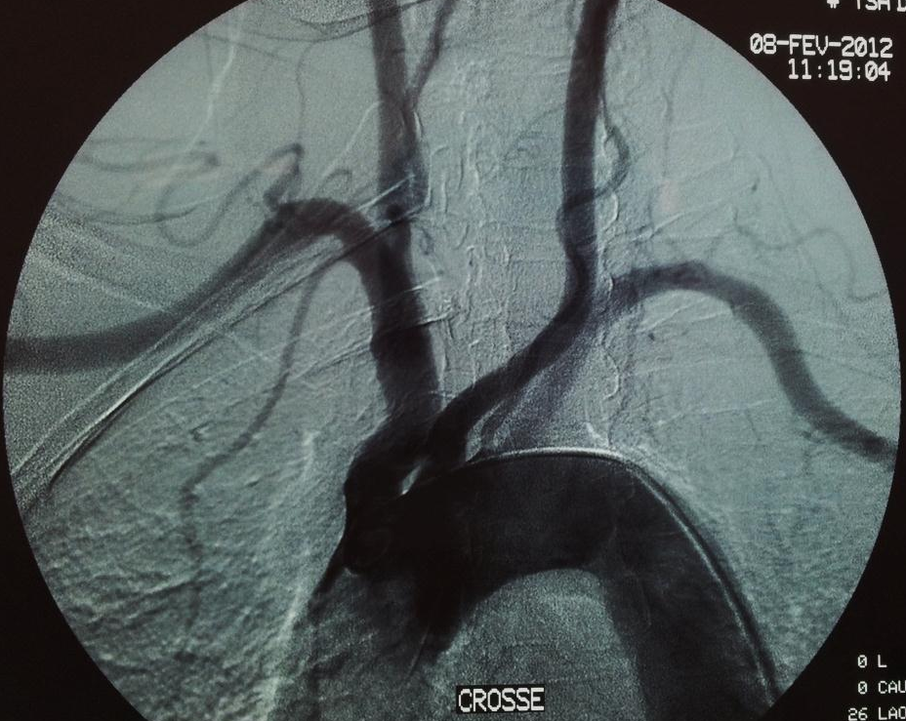
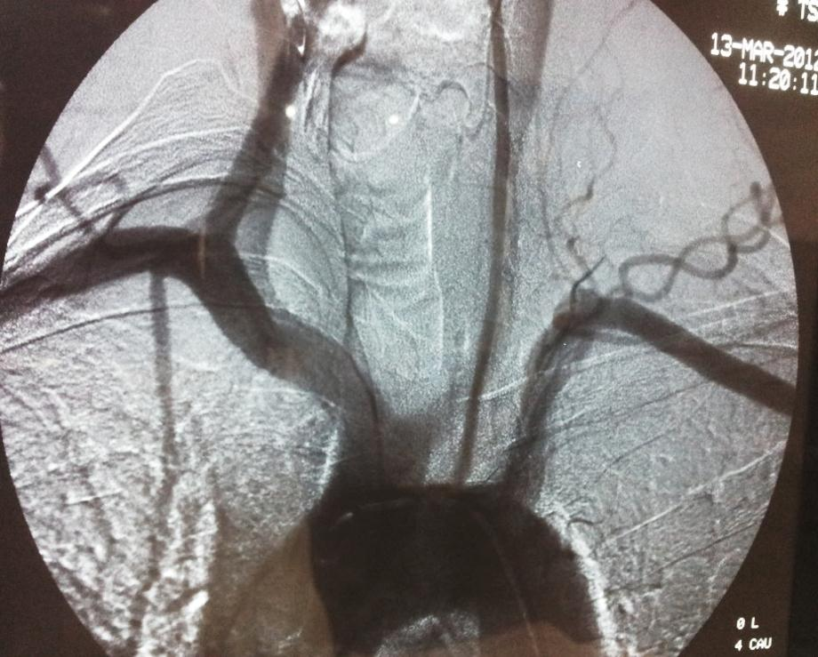
VERTEBRAL ARTERIES VARIANTS :
LVA
LVA
Arcus Ao
Arcus Ao
Figure. 11 : Antero-posterior projection digital substraction aortogram show left vertebral artery rising directly from the aortic arch in two patients.
Arcus Ao : Aortic arch, LCCA : left common carotid artery, LSCA : left subclavian artery, RCCA : right cammon carotid artery, RSCA : right subclavian artery, Trunc bic : truncus bicaroticus.

Slide 25
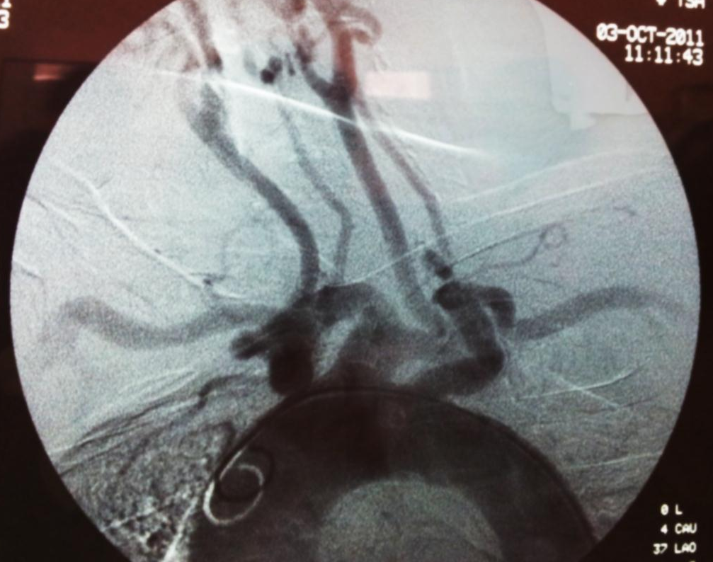
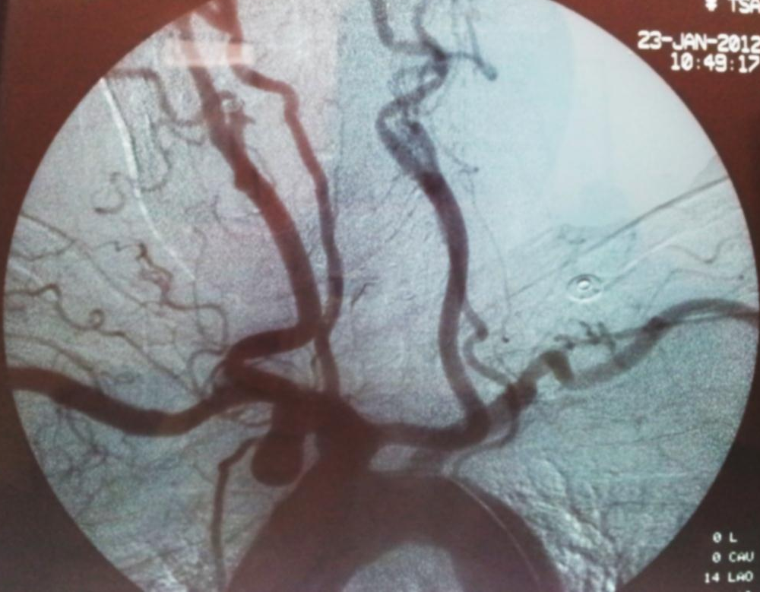
VERTEBRAL ARTERIES VARIANTS :
RVA
RVA
LVA
LVA
A
Arcus Ao
Arcus Ao
B
Figure. 12 : Antero-posterior projection digital substraction aortogram shows :
A. Right vertebral artery rising from the RBA.
B. RVA rising from the RBA and an hypoplasic LVA originating from the aortic arch.
Arcus Ao : Aortic arch, LVA : left vertebral artery, RVA : right vertebral artery, RBA : right brachiocephalic artery.

Slide 26
ABREVIATIONS :
ARSA : Aberrant right subclavian artery
BCA : Brachiocephalic artery
LAA : left aortic arch
LCCA : Left common carotid artery
LDA : Left ductus arteriosus
LSA : Left subclavian artery
LVA : Left vertebral artery
RAA : Right aortic arch
RCCA : Right common carotid artery
RSA : Right subclavian artery
RVA : Right vertebral artery

Slide 27
CONCLUSION :
Congenital anomalies of the aortic arch are frequent. They must be detected, essential preoperatively, in order to adapt intervention and limit potential complications
Understanding the embryologic development and imaging features of the normal aortic arch and its anomalous variants can enable radiologists to make a more informed diagnosis of aortic arch malformations and associated cardiac lesions.

Slide 28
REFERENCES :
Goldmuntz E. The epidemiology and genetics of congenital heart disease. Clin Perinatol. 2001;28:1–10.
Kocis KC, Midgley FM, Ruckman RN. Aortic arch complex anomalies: 20-year experience with symptoms, diagnosis, associated cardiac defects, and surgical repair. Pediatr Cardiol. 1997; 18:127–132.
Devin CJ, Kang JD. Vertebral artery injury in cervical spine surgery. Instr Course Lect. 2009; 58:717-28.
Anson BV, Mcvay CB. Surgical anatomy. 5th ed. Philadelphia: WB Saunders; 1971.
Stojanovska J, Cascade PN, Chong S, Quint LE, Sundaram Baskaran, Embryology and Imaging Review of Aortic Arch Anomalies. J Thorac Imaging 2012;27:73–84.
Verin AL, Creuze N, Musset D, Multidetector CT Scan Findings of a Right Aberrant Retroesophageal Vertebral Artery With an Anomalous Origin From a Cervical Aortic Arch. Chest 2010; 138: 418-422.
Piyavisetpat N, Thaksinawisut P, Tumkosit M, Aortic arch branches’ variations detected on chest CT. Asian Biomed. 2011; 5 :817-823
Ramaswamy P, Lytrivi ID, Thanjan MT, et al. Frequency of aberrant subclavian artery, arch laterality, and associated intracardiac anomalies detected by echocardiography. Am J Cardiol. 2008;101:677–682.
Nayak SR, Pai MM, Prabhu LV, D’Costa S, Shetty Prakash, Anatomical organization of aortic arch variations in the India: embryological basis and review. J Vasc Bras 2006; 5: 2: 95-100.

Slide 29
ABSTRACT :
Objectives : Congenital anomalies of the aortic arch complex are frequent and may be incidentally revealed in asymptomatic forms. There detection is useful, even essential preoperatively, in order to adapt the intervention and limit potential complications. We aim to provide an overview of its variants met in our department.
Materials and methods : We describe angiographic finding in patients with aortic arch variants.

Slide 30
ABSTRACT :
Results : This pictorial essay reviews the angiographic and computed –tomography appearances of many congenital variations of the aortic arch met in our department. A literature review helps us showing embryogenesis of some of these anomalies, describing their frequencies, clinical and radiological appearances.
Conclusion : Congenital anomalies of the aortic arch are frequent. They must be detected, essential preoperatively, in order to adapt intervention and limit potential complications.

