Slide 1
ARTERIOVENOUS FISTULAS EXPLORATION IN HEMODIALYSIS PATIENTS WITH MDCT : AN ICONOGRAPHIC REVIEW
M.Laadhari, N.Mama, *S.Mrabet , H.Moulahi, *H. Zellama, N.Arifa, H.Jemni, K.Tlili
Department of Medical Imaging, *Department of Nephrology, Sahloul,4000 Sousse, Tunisia
-PAN ARAB 2012-INTERVENTIONAL : INTV 13

Slide 2
INTRODUCTION
The creation of an arterio-venous fistula (AVF) is an important procedure to facilitate long-term hemodialysis in patients with chronic renal failure.
Repeated AVF puncture may cause puncture site bleeding and fibrosis, leading to various complications such as stenosis and thrombosis.
Complications at vascular access sites must be diagnosed and treated early to maintain quality of life for patients with end-stage renal disease

Slide 3
Physical examination, sonography, and measurement of recirculation are relied on to screen patients for possible AVF complications, but these measures may not provide sufficient anatomic details for treatment planning.
The recent introduction of MDCT scanners has prompted wider use of CT for assessing the vascular system.
The recent advances in MDCT have led to an increase in the creation and interpretation of images in planes other than the traditional axial images.

Slide 4
purpose
Know the technical realization of a CT angiography (CTA) of arterio-venous fistula.
Know the different patterns found by angiography in case of malfunction of the AVF.

Slide 5
Materiels and methodes
Retrospective study collated over a period of 1 year (August 2010-October2011)
12 cases of patients with end-stage renal failure ESRD on hemodialysis.
All patients were explored by a fistulo-CT for clinical and Doppler fault with the FAV.

Slide 6
MDCT angiography-METHODE
MDCTA was performed using a 16-slice CT Scanner (GE).
The patient was placed in a supine position with upper extremities lying next to the body adducted on the CT table.
The scan is performed after administration into a vein of the limb contralateral to the side of the FAV of 100 mL of nonionic contrast material at 3-4 ml / s.
The vessels in the upper extremity were scanned along the craniocaudal axis starting from neck to the end of upper extremity
Axial sections were obtained over the entire surface of the AVF and are extended to the anastomosis of the subclavian vein sub-ipsilateral.
The vesting period is controlled visually (Smart Prep).
Maximum Intensity Projection (MIP) and 3D-angiography techniques are used in post-processing

Slide 7
Results
8 females and 4 males
Average age 46.5 years (23-74 years)
Lesions found:
2 cases of venous stenosis just before the drainage in subclavian vein.
7 cases of post-anastomotic stenosis.
3 cases of aneurysmal dilatation of the cephalic vein.
1 case of stenosis of the brachial artery was associated venous stenosis.
1 case of extended vein thrombosis
Treatment:
2 patients had AVF plastic surgery
8 of them had no surgery
2 patients had a new AVF

Slide 8
Case 1
35 year old woman, ESRF secondary to membranoproliferative nephritis.
Right humero-cephalic AVF.
significant pain at the puncture of the FAV
DOPPLER:
permeable FAV
5mm diameter
flow was estimated at 1l/mn
absence of arterial stenosis on the side.
Anevrysmal venous dilatation in front of the AVF with stenosis extended over 2cm

Slide 9
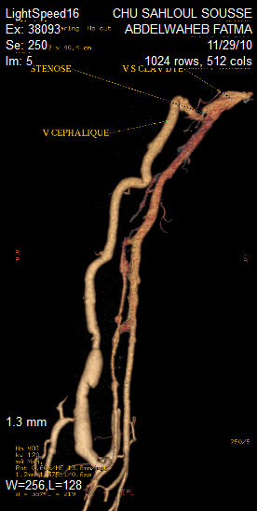
MIP Reconstruction
VR Reconstruction
CTA OF THE RIGHT UPPER LIMB:
Cephalic vein dilated along its route, aneurysmal in its proximal portion.
Short stenosis just before its opening in the subclavian vein.
Opacification of multiple collateral peri anastomotic veins attesting to the severity of the stenosis. As the site of stenosis was very proximal, there was no possible surgery.

Slide 10
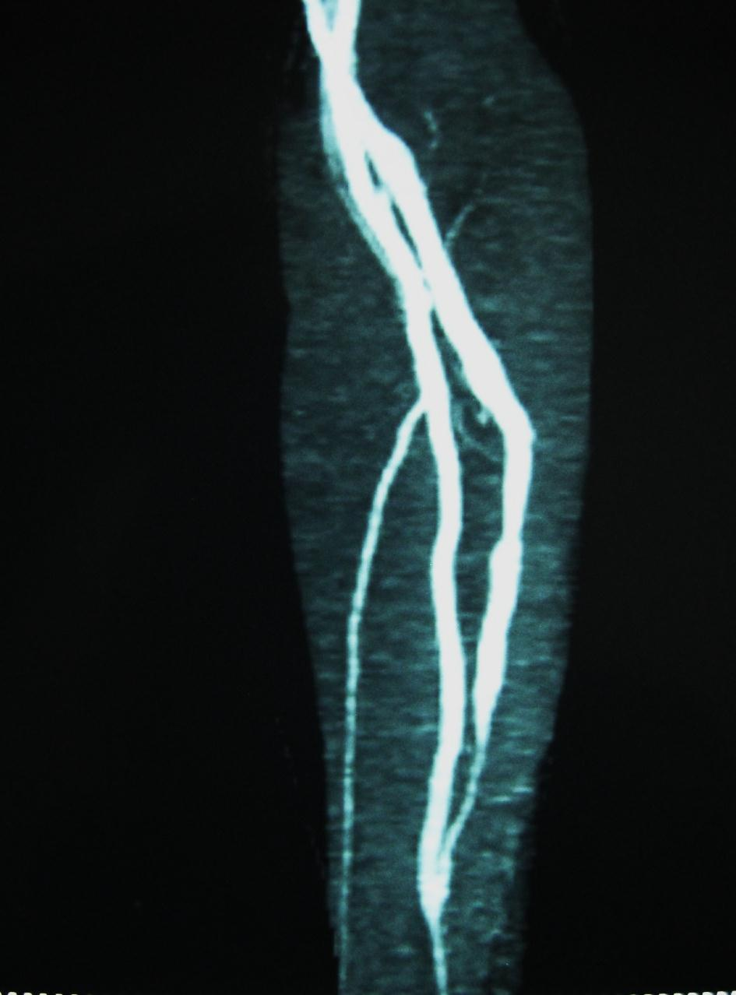
Case 2
50 years-old man.
ESRF secondary to diabetic nephropathy
left radial non-aneurysmal FAV,
important decrease of the FAV Thrill and low flow at the beginning of several HD sessions
Compression time: 5 minutes
DOPPLER : - permeable FAV
- correct FAV debit: estimated 300cc/mn
- no abnormality on the arterial side
- extensive stenosis on the proximal portion of the draining vein with a diameter estimated at 1.5 mm.
LEFT UPPER LIMB CTA : MIP RECONSTRUCTION venous proximal stenosis extent of 4.5 cm
Treatment: Resection of the stenotic portion and radial vein plasty

Slide 11
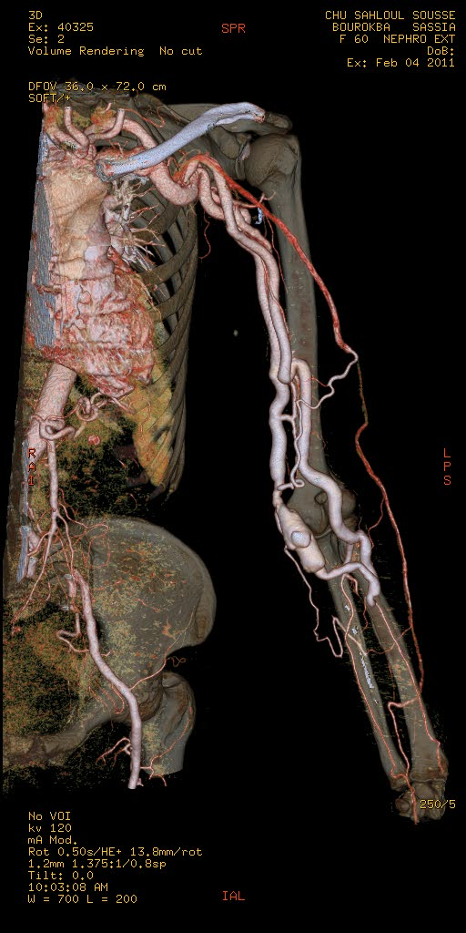
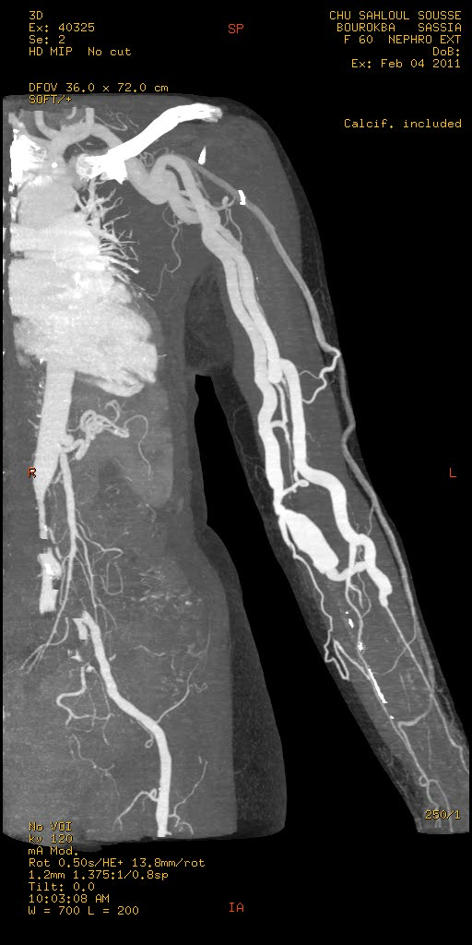
Case 3
60 years-old women with low flow rate of the AVF
AVF between the radial artery and the left basilic vein
DOPPLER :
Debit decrease estimated at 50-70 ml / min with several atheromatous plates
Partial thrombosis in the FAV
MDCT angiography: stenosis on the venous side extent over 20mm
the patient has completed entirely the AVF thrombosis.
Replacement by gortex allograft.

Slide 12
Case 4
30 years-old woman with proximal radial AVF. Prolonged compression time after HD.
THE ECHO-DOPPLER: venous stenosis of the cephalic vein
CTA: short stenosis of the cephalic vein after a post anastomotic anevrysmal dilatation(16 mm)
No surgery was done, the patient continue to make hemodialysis by the same fistula

Slide 13
Case 5
30 years-old with proximal radial AVF. Edema of the left upper limb and prolonged compression time
As hemodialysis is still possible and correct and the patient refuses confection of another AVF, we continued to monitor the patient.
CTA: Basilic vein thrombosis extended to the subclavian vein. Homolateral jugular vein is very thin. Important superficial collateral circulation .This thrombosis is secondary to previous vein catheterism.

Slide 14
Discussion FAV :generalities
Increasing number of patients with end-stage renal disease are now undergoing hemodialysis.
Maintenance of adequate vascular access function is one of the challenges of longterm hemodialysis, and functioning vascular access is essential for this.
Arteriovenous fistulas (AVFs) remain the access type of choice but synthetic arteriovenous grafts are also use.

Slide 15
FAV :possible assemblies in order of preference
FAV radial:
end-anastomosis between the radial artery and cephalic vein at the wrist.
The puncture is allowed after one month.
The main complications are anastomotic strictures or juxtaposition of the puncture points.
FAV ulnar:
anastomosing the basilic vein in the lateral ulnar artery.
The period of maturation before puncture is often long (3-4 months).
The most common complications are the same as the radial AVF.
Cephalic AVF:
Lateroterminale anastomosis between the brachial artery and cephalic vein at the elbow.
The period of maturation can reach more than a month.
The passage of the cephalic vein through the clavi-pectoral fascia is a source of stenosis.
FAV basilica:
concerns the brachial artery and basilic vein at the elbow.
The path from the basilic vein will quickly leave the area, forcing the superficialization at least two months after the creation of the AVF, once the vein is well dilated.
stenosis of the proximal end of the superficialization++

Slide 16
Discussion FAV: COMPLiCATIONS
thrombosis, stenosis, infection, arterial steal syndrome, venous hypertension, aneurysms and congestive heart failure.
Fistula complications are a major cause of morbidity
The diagnosis of dysfunction is clinical at first

Slide 17
Clinical signs of dysfunction
Signs of hypertension reflecting stenosis on the venous side in case of:
FAV aneurysm
prolonged bleeding after the session,
the appearance of collateral + + +,
increased pressure dialysis,
decreased thrill
Signs of low flow with suspected anastomotic or juxta-anastomotic stenosis:
flat fistula
puncture difficulties
reducing pressure dialysis
FAV with a prominent pulsation has to fear a pre thrombose
hyperdebit signs like heart failure, ischemia downstream of the fistula.

Slide 18
Discussion complications : ASSESSMENT
Color Doppler imaging
detecting, locating, and characterizing vascular complications at hemodialysis access sites.
non-invasive.
does not reveal proximal vein stenosis well (low-diagnostic accuracy)

Slide 19
Discussion complications : ASSESSMENT
Fistulography:
the gold standard for assessing hemodialysis fistula malfunction.
before surgery or percutaneous interventions, is the method of choice for detecting and grading stenosis in an AVF and the venous outflow segments.
performed simultaneously with various forms of endovascular treatment, including thrombolysis, thromboaspiration, angioplasty, stent insertion, and mechanical thrombectomy.
This technique requires direct puncture of venous site and complications may occur.
We detected minor complications like extravasation of contrast material and puncture site hematoma in 5% of the patients during fistulography.

Slide 20
In certain cases, digital subtraction angiography (DSA) with arterial puncture is necessary to assess the anastomosis site and arterial pathologies
Analysis of the 2D DSA images may be difficult because of overlapping vessels.
Invasive, it induces discomfort .
the feeding artery and the arterial segment of the anastomosis may not be depicted in their entirety on DSA because of incomplete retrograde filling.
the puncture site for DSA may occasionally differ (opposite direction, too proximal or distal to the stenosis) from the site for the subsequent percutaneous intervention, necessitating a second puncture.

Slide 21
Magnetic resonance (MR) angiography
Lack of radiation exposure and avoidance of nephrotoxicity from iodinated contrast
long-examination time
Artifacts due to turbulent flow at the AVF site
Stenosis severity may be overestimated.
Contraindicated in patients who have pacemakers and in those with incompatible protheses

Slide 22
MDCT angiography
The recent introduction of MDCT scanners has prompted wider use of CTA for assessing the vascular system.
MDCT has improved CTA substantially in various ways:
shorter acquisition time,
increased volume coverage,
lower doses of contrast medium,
improved spatial resolution for assessing smaller arterial branches
CT angiography (CTA) clearly depicts vessel abnormalities such as stenosis, ulcers, pseudoaneurysms, calcifications, plaques, intimal thickening and stent ingrowth.

Slide 23
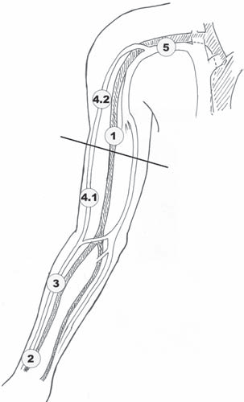
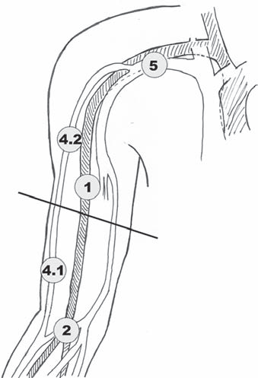
Discussion MDCT ANGIOGRAPHY
Schematic overview of arteriovenous fistulas (AVFs)
Different vascular segments used for evaluation were complete arterial inflow (1) for MDCT angiography only, arteriovenous anastomosis (2),
forearm venous outflow for radiocephalic AVF only (3), proximal half of upper arm venous outflow (4.1), distal half of upper arm venous outflow (4.2), and central veins (5).

Slide 24
The most widely, used 3D angiography techniques are maximum-intensity projection (MIP) and, more recently, volume-rendering technique (VRT)
Axial MIP, VRT and all-planes evaluations were most sensitive for fistula site detection.
Coronal MIP had the highest sensitivity, specificity and accuracy for detecting venous stenosis.
VRT and all-planes had the highest sensitivity and accuracy for detecting aneurysms.
All-planes and axial MIP were most sensitive for detecting venous occlusion.

Slide 25
The most frequent AVF complications are aneurysm formation, vascular steal syndrome, venous hypertension, hemorrhage, infection and neurological disorders.
MDCTA is very accurate for detecting aneurysms. Further, the length and diameter of the aneurysms could be detected and partial thrombosis of aneurysms was visible only on MDCTA.
Thrombosis of aneurysms was not detectable on conventional fistulography.
MDCTA is also helpful for identifying additional arterial pathologies such as atherosclerotic changes and arterial stenosis in upper extremities with AVFs.
There are no stent artifacts or vascular clip artifacts with MDCTA.

Slide 26
conclusion
MDCT angiography may offer a reliable solution to evaluate dysfunctional hemodialysis fistulas including the complete arterial inflow.
The CTA of FAV is quick and easy implementation, avoids puncture of the AVF, avoids compression maneuver performed per conventional fistulography , provides a vascular arterial and venous mapping and allows exhaustive and objective exploration of the anastomosis.

Slide 27
conclusion
MDCTA overall gives low sensitivity for detection of central vein stenosis and moderate sensitivity for occlusion.
For most pathology, all-planes evaluation of MDCTA gives highest sensitivity and accuracy rates when compared to other planes.
For venous stenosis and occlusion, MDCTA should be considered when ultrasonography and fistulography are inconclusive.
MDCTA is helpful in identifying aneurysms, collaterals, partial venous thromboses and additional arterial, anastomosis site pathologies.

