Slide 1
PARA PHARYNGEAL GERM CELL TUMOR
HN5
R. AOUINI, S. KOUKI, A. HRICHI , I. GANZOUI, M. LANDOULSI , S. BOUGUERRA, Y. AROUS, H. BOUJEMAA, N. BEN ABDALLAH

Slide 2
INTRODUCTION:
Germ cell tumors (GCTs) are a heterogeneous group of lesions which arise in patients of all ages; they occur most frequently in the gonads and are relatively rare in other sites.
Both computed tomography and magnetic resonance imaging (MRI) are highly sensitive in the detection of these tumors.
In this case we report an uncommon localization
of a germ cell tumor which is the Para pharyngeal
space.

Slide 3
MATERIALS AND METHODS:
A 5 year old boy without any medical history complaining of facial paralysis which doesn’t respond to symptomatic treatments and persisting for more than 2 weeks.
A CT scan was performed with axial, frontal and
sagittal reconstruction before and after injection
of a contrast agent.

Slide 4
RESULTS:
Physical examination revealed only a peripheral facial paralysis.
Laboratory studies disclosed no abnormalities in the hemogram or urinanalysis.
Serum α-fetoprotein level was elevated.
Human chorionic gonadotropin (HCG) determination was normal.

Slide 5
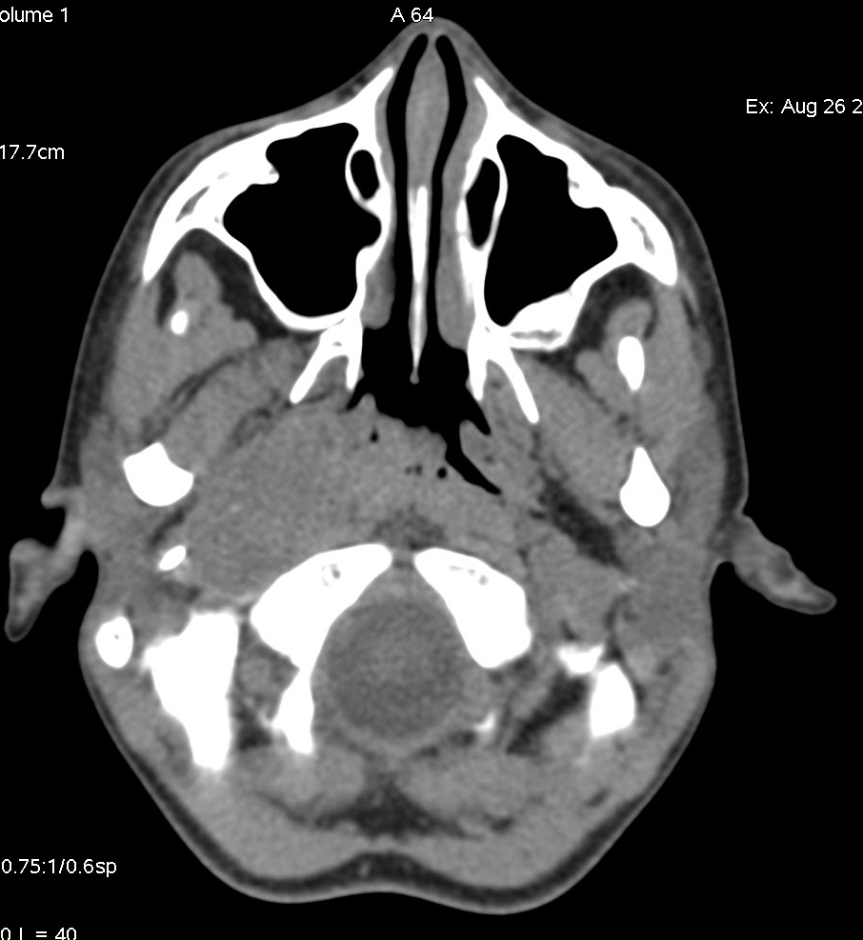
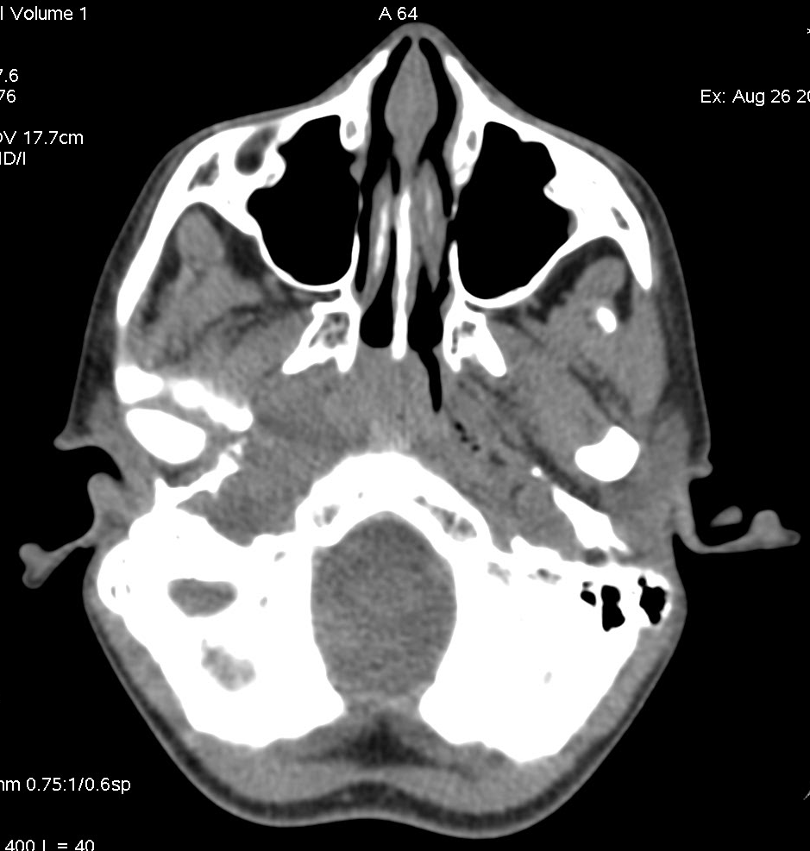
Unenhanced CT scan shows a welll-circumscribed homogeneous and isodense mass measuring 35 x 20 mm of diametres in the right parapharyngeal space repressing the medial pterygoid muscle and filling the Eustachian tube and the fossa of Rosen muller.
This lesion extends to the infra temporal space.

Slide 6
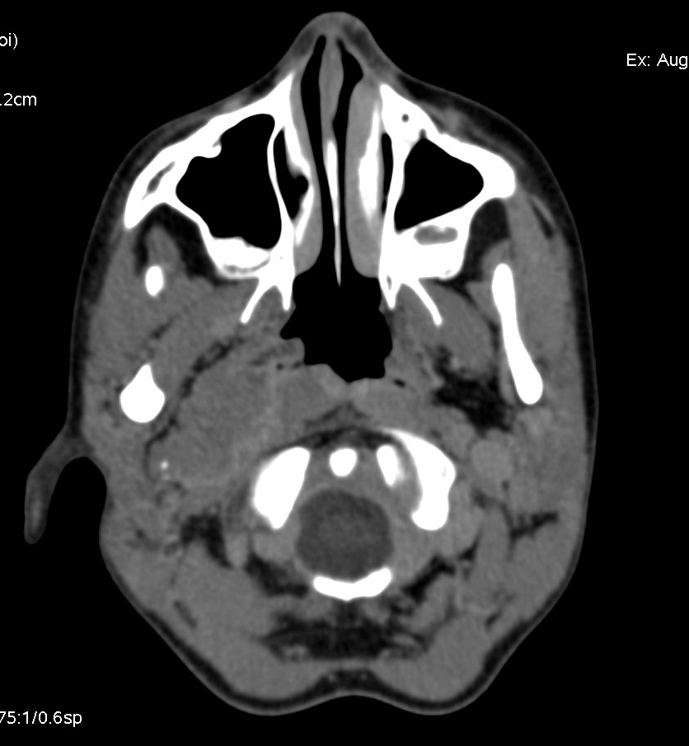
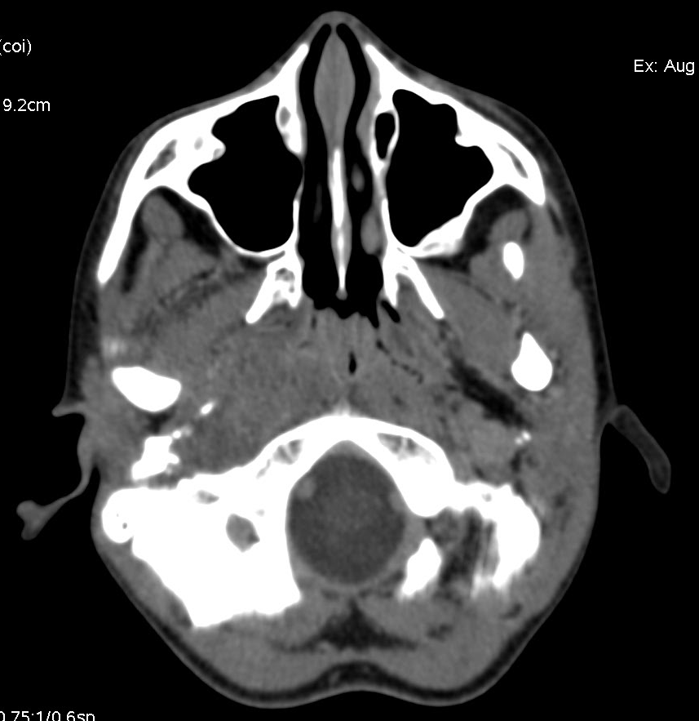
This mass shows a heterogeneous enhancement after contrast administration, the low-attenuation
area corresponds to necrosis. The mass represses the neck vessels.

Slide 7
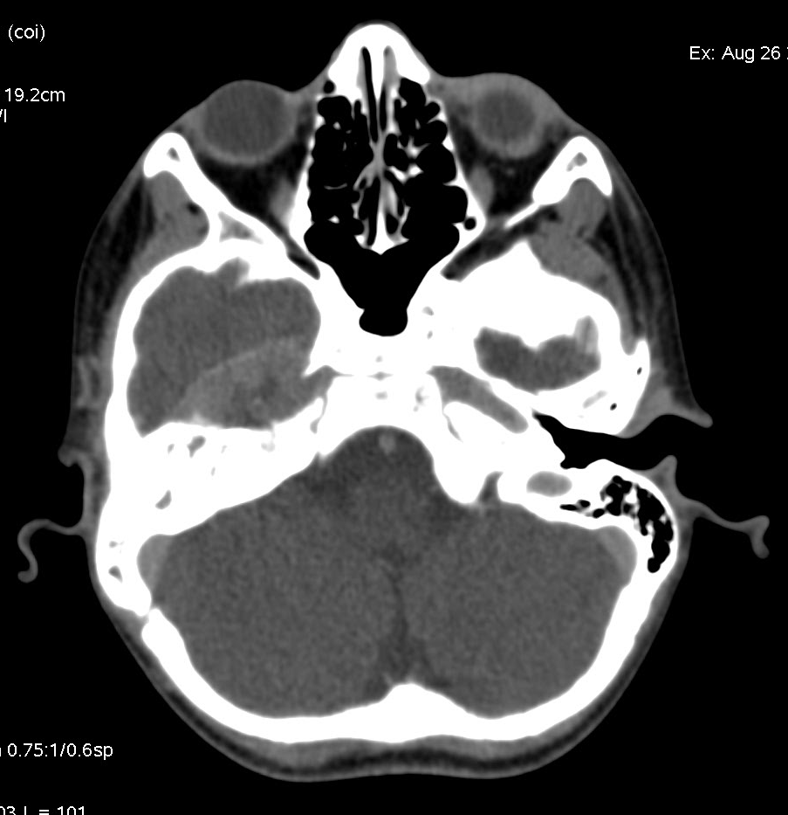
This mass also invades the right temporal lobe with the presence of hypoattenuating unenhanced areas at CT corresponding to necrosis.

Slide 8
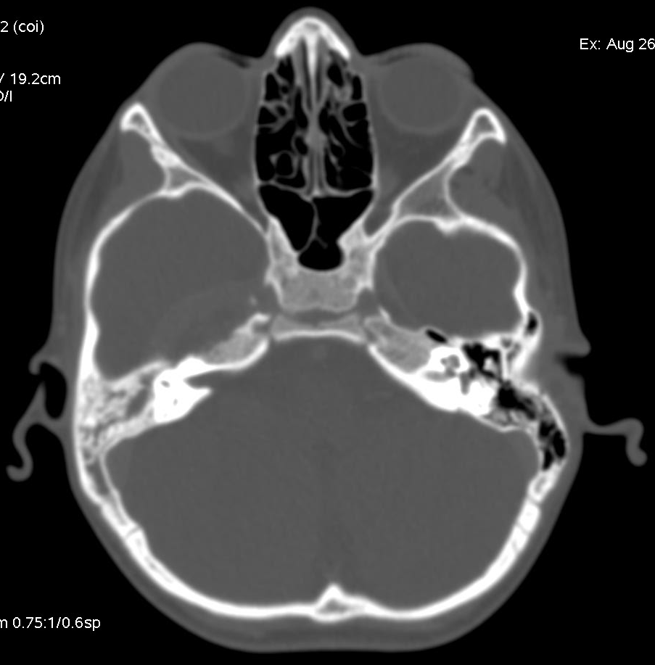
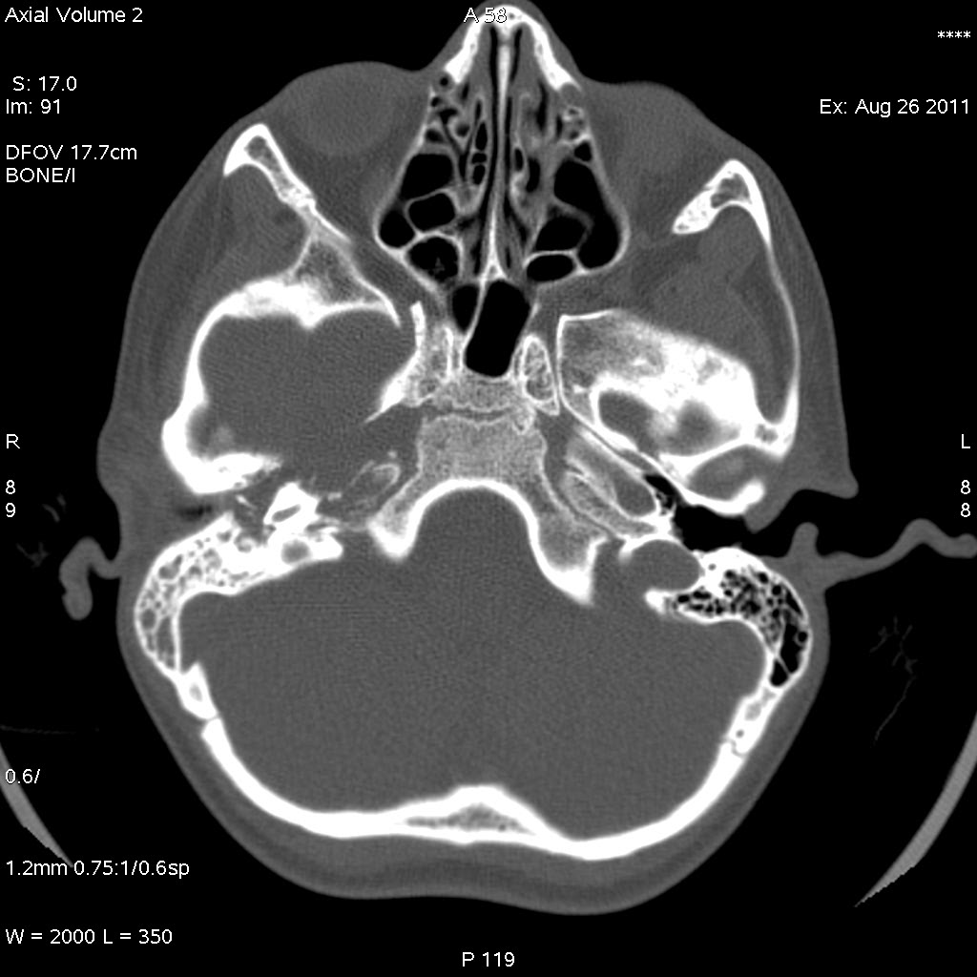
right middle ear is filled with integrity of the ossicular chain.
No evidence of vestibular or labyrinthic invasion.
lysis of the petrous part of temporal bone responsible for a lesion of the facial nerve.

Slide 9
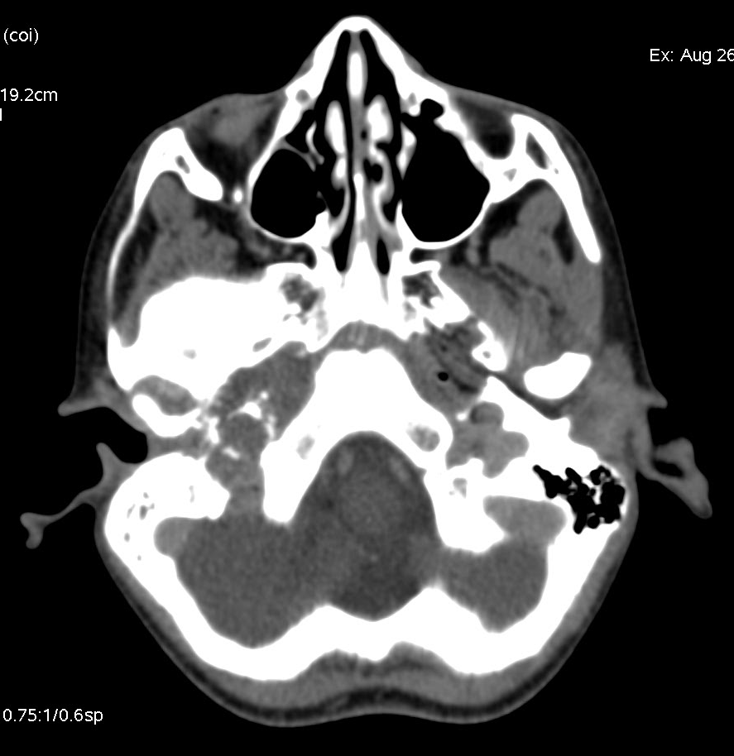
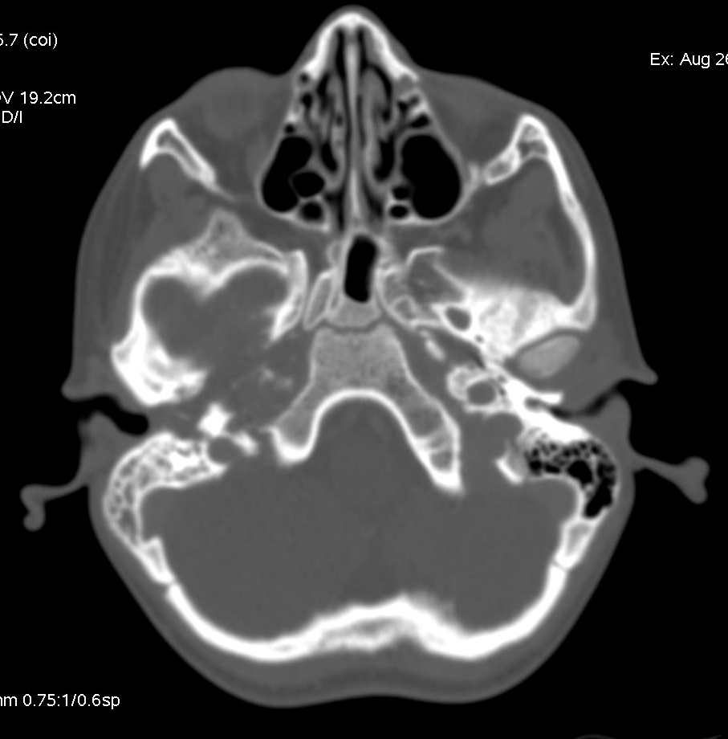
hyperdense images testify of the presence of bone destruction
with small fragments detached

Slide 10
DISCUSSION:
Germ cell tumors are neoplasms arising from primordial germ cells and are composed of embryonic ectodermal, mesodermal, and endodermal tissue and/or extra-embryonic tissues, such as trophoblast and yolk sac.
Embryologic and histopathologic considerations suggest two different origins of extragonadal GCTs: metastases from gonadal GCTs and primary GCTs originating from migrated primordial germ cells.
Among the various histologic subtypes of GCTs benign teratomas are most frequently found[8]. Overall, the prevalence of nonseminomatous GCTs is much less than that of seminomas.

Slide 11
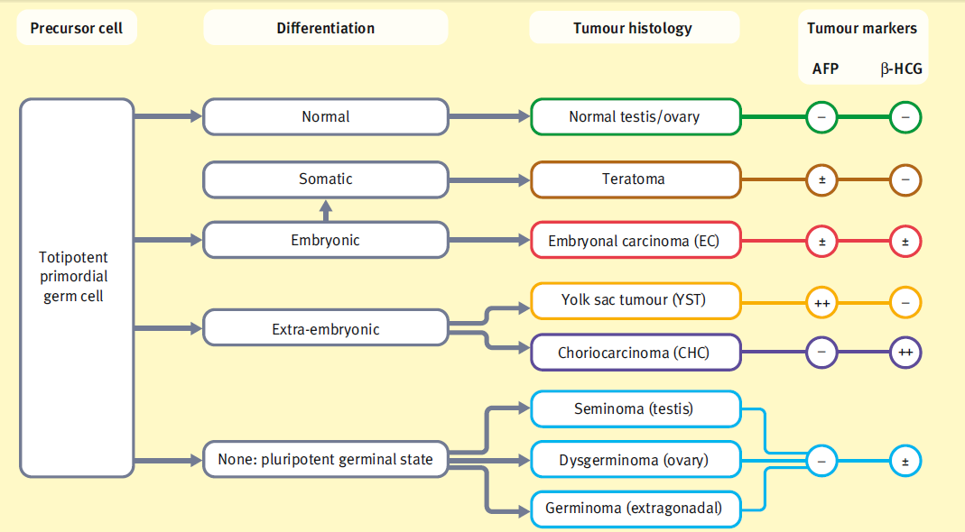
Derivation of germ cell tumors[1].

Slide 12
GCTs mainly occur in the gonads and localization at extragonadal sites(e i :no evidence of a primary tumor in either the testes or the ovaries.[3] ) is uncommon.
Most extragonadal GCTs occur in the median line of the human body: the anterior mediastinum, sacrococcygeal region, pineal gland, and neurohypophysis are common sites.
In extracranial head and neck regions, they are extremely rare: 5%[4,5,6,7]
the histologic features of each tumor variety are similar wherever it occurs.[9]

Slide 13
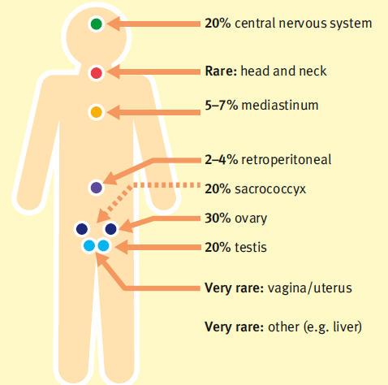
Site distribution and frequency of germ cell tumors (children < 15 years).[1]

Slide 14
The age at diagnosis shows a bimodal peak with an increased incidence in the first four years of life and then from second to fourth decade of life.[2]
Abnormal karyotypes, and Conditions such as male cryptorchidism, aniridia-Wilms’ association, sacral agenesis and males with Russell-Silver syndrome have an increased risk of GCTs.[2]

Slide 15
In general, GCTs tend to occur as indolent masses, and clinical symptoms are mostly related to local dysfunction by tumor growth, the paralysis of the cranial nerves can be the first manifestation especially the V, VII, IX, X, XII.
In our case peripheral facial paralysis was the only clinical manifestation leading to perform a facial and cerebral CT scan.
Secretion of AFP and less commonly ß-HCG can be important in diagnosis, assessing treatment response and post-treatment surveillance (CSF measurement in suspected intracranial GCTs is mandatory.)

Slide 16
Radiologic findings varies depending on the histologic type of tumor (seminoma, non seminomatois GCTs, teratoma):
Seminomas produce a bulky lobulated well marginated solid homogeneous with fibrovascular septa(low-signal intensity bands on T2), mildly enhancing masses on CT[9,10], calcification are rarely seen. MRI appearance is non specific.
Local invasion is uncommon, however lymph node
metatases are often present at presentation[9].

Slide 17
Teratomas may be mature (benign) or immature (with variable malignant potential)[9]:
Malignant teratomas usually have a large solid component and a mixed histology, with the presence of elements of other germ cell tumors.
Mature teratomas appear as well-defined lobulated heterogeneous solid or cystic masses. Calcifications are found in ¼ to 1/3 of cases.

Slide 18
Non seminomatous GCTs are usually large, lobulated, heterogeneous and infiltrating masses with irregular margins containing calcification, hemorrhage, and necrosis.
MRI allow better characterization of the different
components of the tumor such as areas of
hemmorage which appear as hyperintense on T1
weighted images, cysts and necrotic areas as
hyperintense on T2-weighted images.
Invasion of adjacent organs is common[9,10].

Slide 19
The diagnosis is based on biopsy and assay of specific serum markers including alpha-foeto protein (A.F.P).
In our case histology shows a tumor proliferation
associated with the classic Schiller-Duval bodies which
are characterized by a central blood vessel covered by
tumor cells and separated from an outer rim of tumor cells
by a clear space.
Histopathologically Schiller Duval bodies when present are pathognomonic of the Yolk sac tumor.

Slide 20
The treatement and the prognosis for GCTs depends on the histologic subtype:
Treatment of mature teratomas is completed only by surgical removal.
Seminomas, are very sensitive to radiation and chemotherapy.
Non seminomatous GCTs should benefit of surgical removal when its possible, in association with a multi-agent chemotherapy.[8]
Their prognosis is poor due to their aggressivity and deep
location responsible for delayed diagnosis.

Slide 21
CONCLUSION:
Extragonadal germ cell tumors have a variable clinical course, with the potential for aggressive behavior and widespread metastases.
The imaging characteristics of these tumors are
nonspecific, and in combination with other clinical
data, including tumor markers, should always lead
to consideration of extragonadal germ cell tumors
and the definitive diagnosis of extragonadal GCTs
requires a biopsy.

Slide 22
BIBLIOGRAPHIE:
1-Nadira Mamoon,1 Sadaf Ali Jaffri,2 Fazal Ilahi,3 Kamil Muzaffar,4 Yasir Iqbal,5 Noreen Akhter,6 Humaira Nasir,7 Imran Nazir Ahmad8 Yolk sac tumour arising in mature teratoma in the parapharyngeal spaceJ Pak Med Assoc.
2-Matthew Jonathan Murray, James Christopher Nicholson, Germ cell tumors in children and adolescents, Paediatrics and child health 20:3.
3-Gabriele Calaminus, Catherine Patte Germ Cell Tumors in Children and
Adolescents international society of pediatric oncology.
4-Kusumakumari P., Geetha N., Chellam VG., Nair MK. Endodermal sinus
tumors in the head and neck region. Med Pediatr Oncol. 1997; 29(4):303-7.
5Lack EE. Extragonadal germ cell tumors of the head and neck region: review of 16 cases. Hum Pathol. 1985 ; 16(1):56-64.
6-Dehner LP., Mills A., Talerman A., Billman GF., Krous HF., Platz CE. Germ cell neoplasms of head and neck soft tissues: a pathologic spectrum of teratomatous and endodermal sinus tumors. Hum Pathol. 1990; 21(3):309-18.

Slide 23
7-I. Gassab, A. Hamroun, K. Harrathi, A. Hizem, F. Ben Mahmoud,F. El Kadhi, A. Moussa*, CH. Hafsa**, J. Koubaa, A.Gassab Tumeur germinale de l’espace parapharyngé: a propos d’un cas. J. TUN ORL - N° 18 JUIN 2007
8-Gerrit-Jan Westerveld, MD, Jasper J. Quak, MD, PhD, Dorine Bresters, MD, PhD, Christian M. Zwaan, MD,Paul Van Der Valk, MD, PhD, and Charles R. Leemans, MD, PhD, Endodermal sinus tumor of the maxillary sinus. Otolaryngology–Head and Neck Surgery June 2001.
9-Atul B. Shinagare, Jyothi P. Jagannathan, Nikhil H. Ramaiya, Matthew N. Hall, Annick D. Van den Abbeele Adult Extragonadal Germ Cell Tumors. AJR:195, October 2010.
10-Teruko Ueno, MD, Yumiko Oishi Tanaka, MD, Michio Nagata, MD Hajime Tsunoda, MD, Izumi Anno, MD, Shigemi Ishikawa, MD Koji Kawai, MD, Yuji Itai, MD, Spectrum of Germ Cell Tumors: From Head to Toe, RadioGraphics 2004.

