Slide 1
NEURORADIOLOGY: NR33

Slide 2
RASMUSSEN'S ENCEPHALITIS IN ADULT: A REPORT CASE
L. EL ASSASSE, S. BOUTACHALI, T. AMIL, A. HANINE, S. CHAOUIR, A. DARBI. Radiology service, Military hospital, Rabat, Morocco

Slide 3
Introduction:
Rasmussen's encephalitis is a rare chronic inflammatory disease characterized by a focal cortical inflammation, with progressive extension and dissemination.
It is a disease which primarily interests the child.
We report in this work an observation of a case of Rasmussen's encephalitis in adult.

Slide 4
Observation:
A 30-year-old woman epileptic since 5 years, with drug-resistant partial epilepsy, presented a progressive left hemibody deficit since 1 month.
An EEG and MRI were performed.

Slide 5
Results:
The electroencephalogram showed bihemispheric epileptic abnormalities predominant in right temporal focus.
The MRI found a right hemispheric cortical atrophy associated with atrophy of the right basal ganglia and an ipsilateral white matter hyperintensity in T2 and FLAIR.
This clinical and radiological presentation allowed the diagnosis of late-onset Rasmussen's encephalitis.

Slide 6
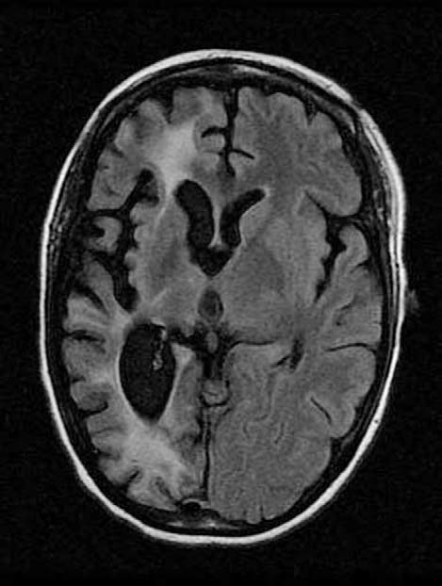
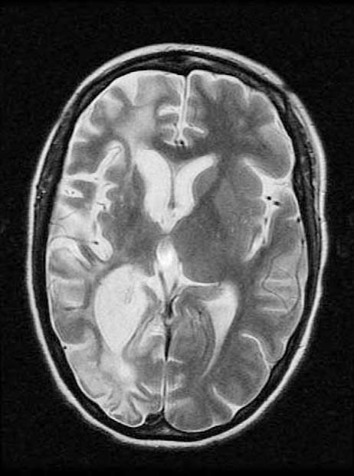
Axial T2 and Flair MRI: Right hemispheric cortical atrophy associated with atrophy of the right basal ganglia and an ipsilateral white matter hyperintensity in T2 and FLAIR.

Slide 7
Discussion:
It is a rare chronic inflammatory disease.
Unknown etiology, probably autoimmune.
Primarily affects children.
Exceptional forms in adolescents or adults have been described.
In literature: 2OO cases reported since the first description by Theodore Rasmussen.

Slide 8
Discussion:
Only 37 cases in adults.
Late adult form :
Mean age: 24 years.
Female predominance.
Slower and less severe evolution than in children.

Slide 9
Discussion:
Clinical presentation:
Drug-resistant partial epilepsy.
Hemibody neurological deficit.
Choreic movement disorders.
Visual seizures.
Electroencephalogram:
Slow activity in one hemisphere.

Slide 10
Discussion:
Biology:
Anti-Glutamate receptor antibodies type 3 (anti GLUR3): positive.

Slide 11
Discussion:
MRI:
Phase 0: No abnormality.
Phase 1: Cortical or white matter hyperintensity on T2 and FLAIR, with increased cortical thickness.
Phase 2: T2 or FLAIR hyperintensity without cortical thickness change.
Phase 3: T2 or FLAIR hyperintensity with cortical atrophy.
Phase 4: cortical atrophy without hyperintensity.

Slide 12
Discussion:
Contrary to the child, these forms are characterized by :
Less frequent neurological deficit.
A higher incidence of bilateral or occipital involvement.
A slower and less severe evolution than in children.

Slide 13
Discussion:
Treatment:
Antiepileptic drugs.
Corticosteroids.
IV Ig.
Plasmapheresis.

Slide 14
conclusion:
Early diagnosis of Rasmussen's encephalitis can tailor the treatment, which is essentially medical in adults.

Slide 15
REFERENCES:
Jaillon-Rivière V, Dupont S, Bertran F, De la Sayette V, Beuvon F,Baulac M, et al. Le syndrome de Rasmussen à début tardif: caractéristiques cliniques et thérapeutiques. Rev Neurol 2007;163:573-80.
Bahi-Buisson N, Nabbout R, Plouin P, Bulteau C, Delalande O,Hertz Pannier L, et al. Avancées actuelles sur les conceptspathogéniques et thérapeutiques de l ’encéphalite de Rasmussen.Rev Neurol 2005;161:395-405.
Freeman JM. Rasmussen’s syndrome: progressive autoimmune multi-focal encephalopathy. Pediatr Neurol 2005;32:295—299.
Kim SJ, Park YD, Hessler R, Lee MR, Smith JR. Correlation between magnetic resonance imaging and histopathologic grades in
Rasmussen’s syndrome. Pediatr Neurol 2010;42:172—6.

